Slide 1
Grade Confirmation Email Bot
Topic -

Slide 2
Presentation by -
Jatin Nehlani and Pratham Oza
BITS Pilani

Slide 3
1.
About STTL
Notes:
Here we discuss one algorithm that enables doing the fast and power efficient use of IoT devices for training.

Slide 4
Silver Touch Technologies Ltd.
Silver Touch is a world-leading and internationally recognized IT Solutions provider and is currently the leading Digital Transformation & Emerging Technologies to assist customers worldwide. Silver Touch, since its inception in 1995, has provided customers and businesses with its new IT Solutions.
They have the highest quality standard certification in the industry:-
CMMi Level 5 Quality Standards
ISO 27001 Information Security Standards
ISO 20000 Service Delivery
ISO 9001 Quality Standards

Slide 5
2.
Digital Transformation
Notes:
Here we discuss one algorithm that enables doing the fast and power efficient use of IoT devices for training.

Slide 6
Digital Transformation
Digital transformation is the adoption of an organization. Common goals for its implementation are to improve efficiency, value, or innovation.
Silver Touch Technologies Ltd. is an IT services provider that excels in digital transformation for the future of the company and better management of its assets.
Types:-
Process Transformation - Companies can revise internal processes to lower costs, improve quality and reduce cycle times.
Business Model Transformation - Business model transformation fundamentally aims to change how companies deliver value for customers.
Domain Transformation - Organizations typically adopt new technologies to redefine their products and services.
Cultural/Organizational Transformation - Embracing a digital-first culture enables organizations to adopt agile workflows, develop a bias toward testing and learning, and support decentralized decision-making.

Slide 7
Advantages of Digital Transformation
Enhanced data collection
Stronger resource management
Data-driven customer insights
A better customer experience
Encourages digital culture (with improved collaboration)
Increased profits
Increased agility
Improved productivity

Slide 8
3.
Robotic Process Automation
Notes:
Here we discuss one algorithm that enables doing the fast and power efficient use of IoT devices for training.

Slide 9
Robotic Process Automation
Robotic process automation (RPA) is a type of automated business process technology based on analog software robots, artificial intelligence (AI), or digital staff. They are sometimes called software robots (not to be confused with robotic software).
The Future of RPA is smarter Automations. The next step, which some organizations are already taking, is to blend attended automation and RPA with artificial intelligence (AI) and machine learning tools. Variously known as intelligent automation, intelligent process automation, and cognitive RPA, this class of solutions enables enterprises to automate more complex, less rule-based tasks. Softwares such as Automation Anywhere, Blue Prism, Ui Path, etc.. support RPA and are used worldwide for bot processing.

Slide 10
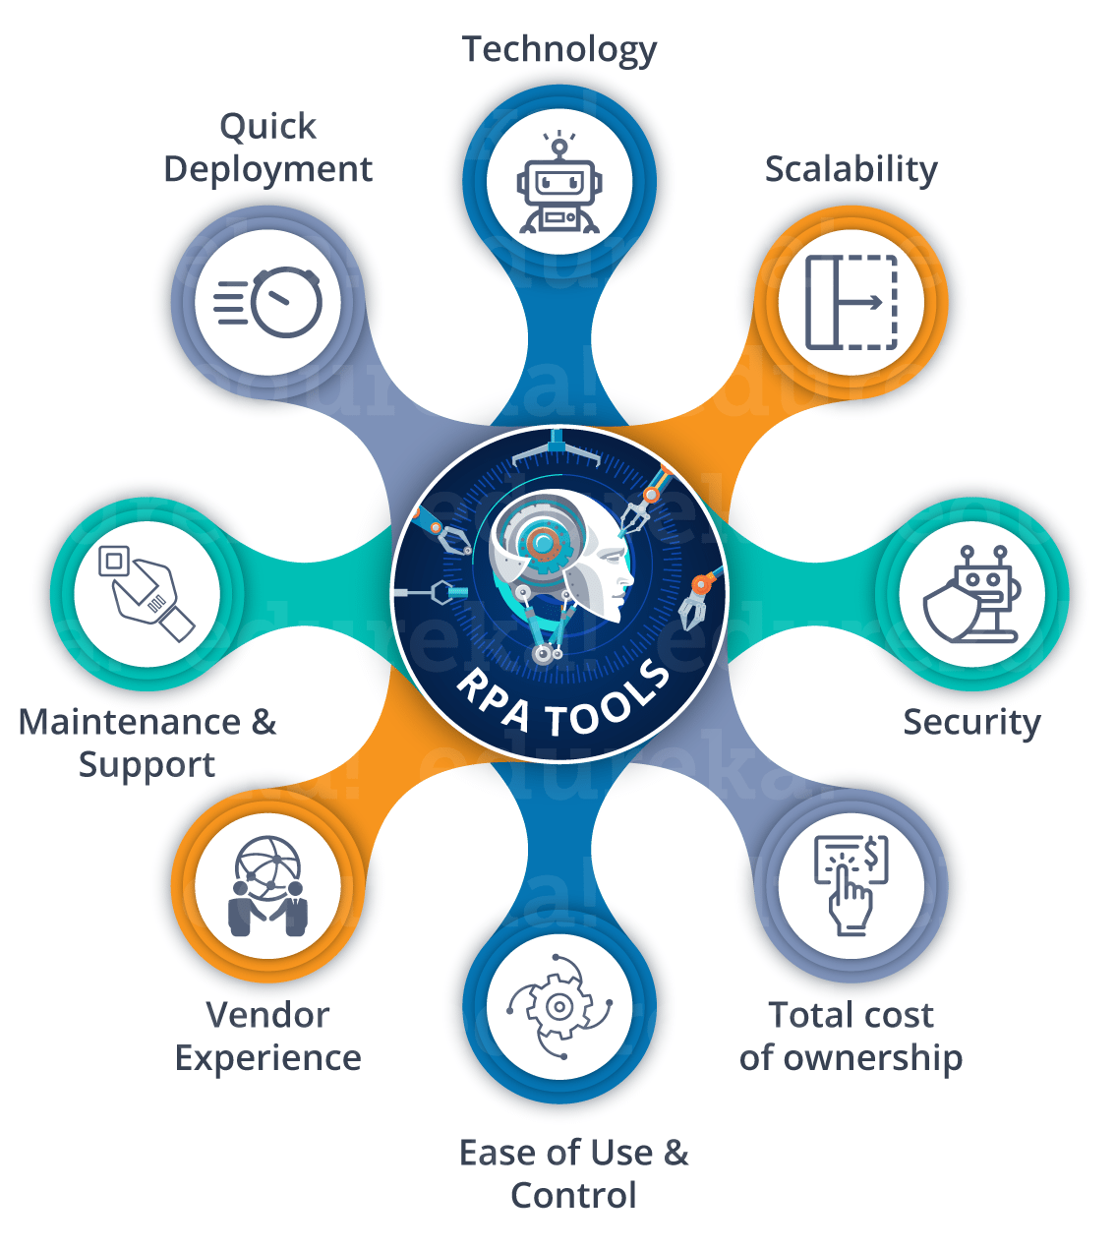

Slide 11
4.
Automation Anywhere
Notes:
Here we discuss one algorithm that enables doing the fast and power efficient use of IoT devices for training.

Slide 12
Automation Anywhere
Automation Anywhere is a Robotic Process Automation tool that allows organizations to automate business processes from start to finish. The prime factor of Automation Anywhere, which makes it different from others and easy to use, is that it requires little to no knowledge of programming languages to create bots. The user interface (UI) of Automation Anywhere is straightforward and easy to understand, even for non-programming people. Automation Anywhere allows us to create three types of bots which are:
Task Bot
Meta Bot
IQ Bot
Task Bot
Use the Run, Pause, and Stop actions in the Task Bot package to manage running one or more child bots from a parent bot or with third-party software using an API.

Slide 13

Automation Anywhere
Meta Bot
MetaBots are highly reusable, create once, and used everywhere bots. MetaBots can be shared across an enterprise or uploaded to the Bot Store to make them available to the entire Automation Anywhere community.
IQ Bot
IQ Bot provides cognitive (intelligent) automation to uncover and transform essential but less structured data to automate business processes quickly and efficiently, simultaneously reducing human error.

Slide 14
5.
Email Package
Notes:
Here we discuss one algorithm that enables doing the fast and power efficient use of IoT devices for training.

Slide 15
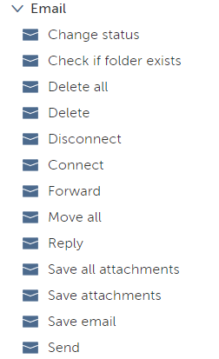
Email Package
The Email package contains actions to automate email-related tasks through Exchange Web Services (EWS), Microsoft Outlook, and other email servers. We can use these actions for sending, receiving, and modifying messages, folders, and the status of messages. It supports EWS, POP3, SMTP, and IMAP protocols.

Slide 16
6.
Credentials & Lockers
Notes:
Here we discuss one algorithm that enables doing the fast and power efficient use of IoT devices for training.

Slide 17
Credentials & Lockers
The Credential Vault securely stores sensitive information such as passwords, account numbers, and social security numbers in credentials and lockers for use in automation tasks. It facilitates role-based access for users of a Control Room and ensures that sensitive values are not stored in bots or on devices.
A locker specifies which users can view, modify, or access. For example, a human resources (HR) locker can hold Email, Database, and Training website credentials and allow only specific employees of the HR department to use the credentials in their bots.

Slide 18
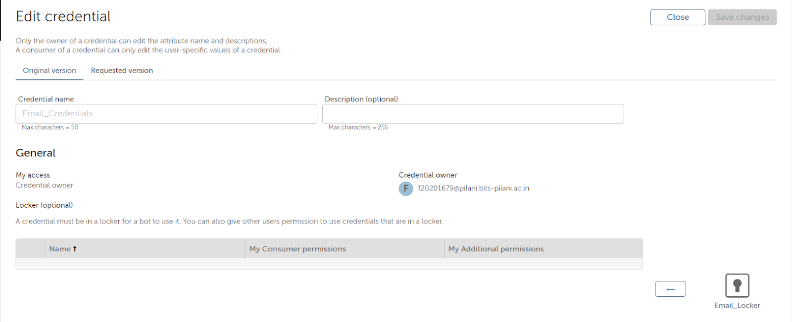
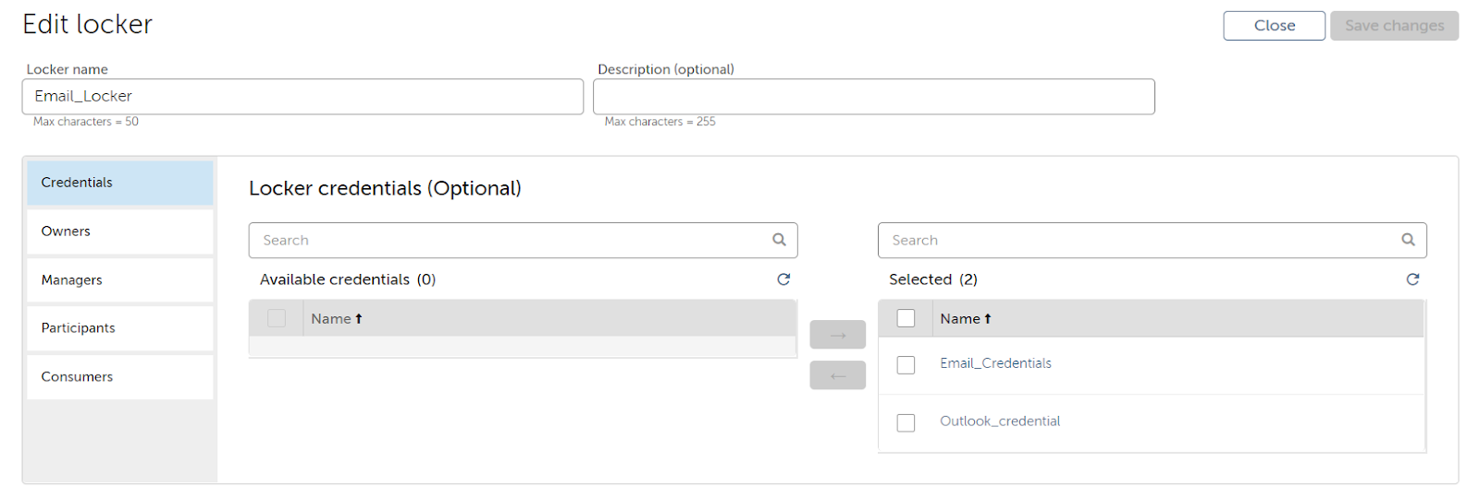
Credentials & Lockers

Slide 19
7.
Code Layout
Notes:
Here we discuss one algorithm that enables doing the fast and power efficient use of IoT devices for training.

Slide 20
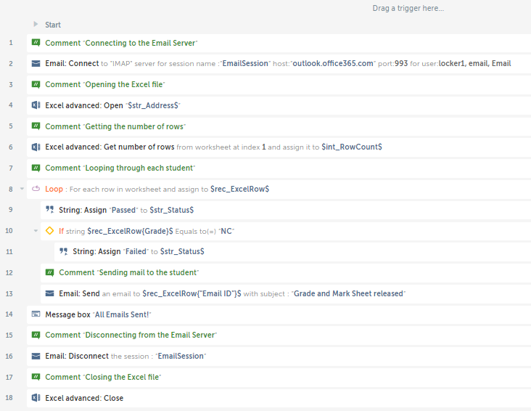
Code Layout

Slide 21
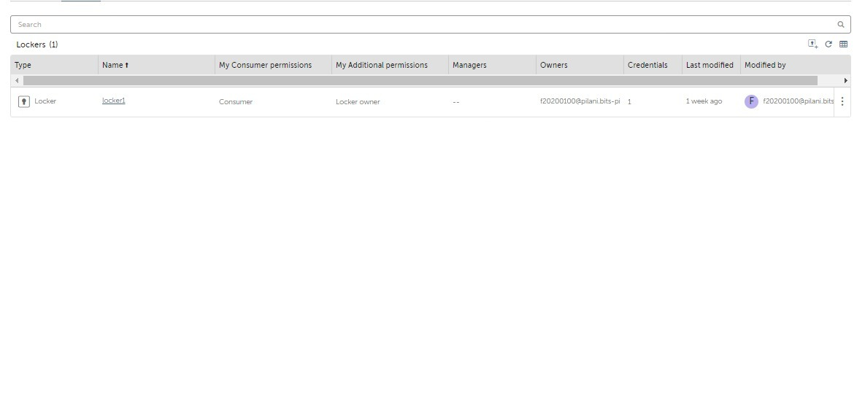
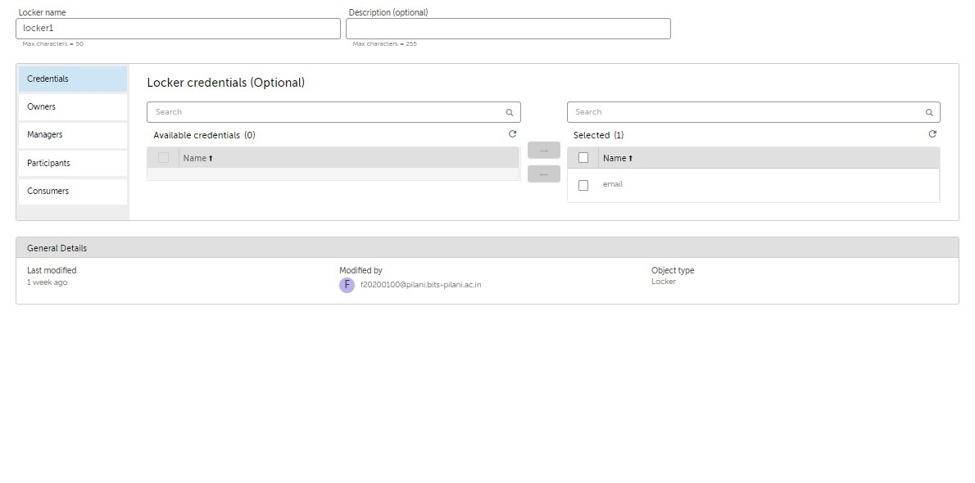
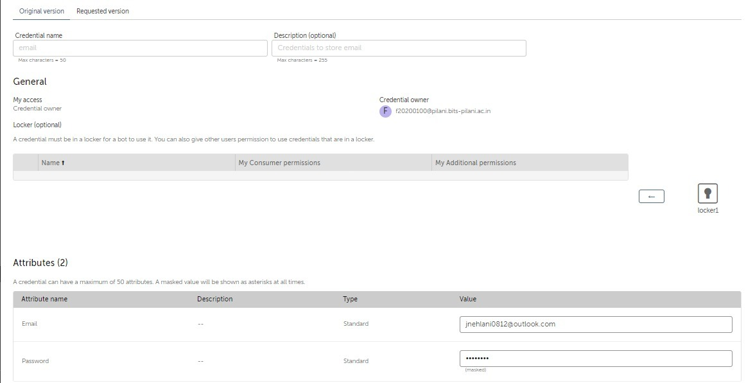
Credential & Locker for our bot
Lockers list
Locker details
Credential details

Slide 22
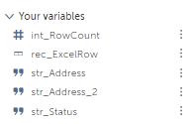
List of Variables

Slide 23
8.
Working
Notes:
Here we discuss one algorithm that enables doing the fast and power efficient use of IoT devices for training.

Slide 24
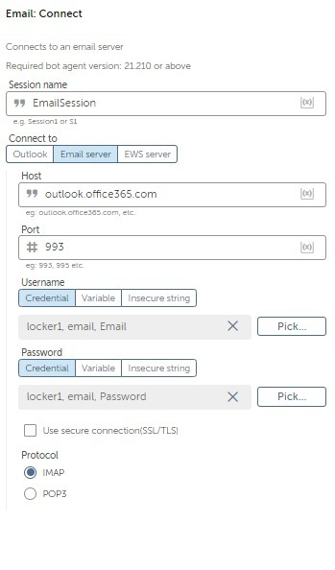
Email Connect
Line 2-
The bot starts by connecting to the Email server using the host, port, and the credentials stored in the credential locker. For this project, we used the outlook server as the host; the port we have used is 993, and we used the IMAP protocol.

Slide 25
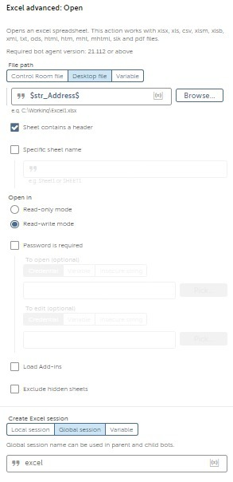
Excel Open
Line 4-
The bot accesses the Student data like Student ID, Student Name, Email ID, and the grade they got stored in the excel file on the desktop using the Excel Advanced command.

Slide 26
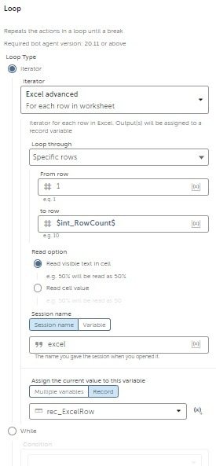
Looping
Line 8-
The bot iterates through all the rows of the excel file and for each row, it stores the whole row in a record to perform actions on it.

Slide 27
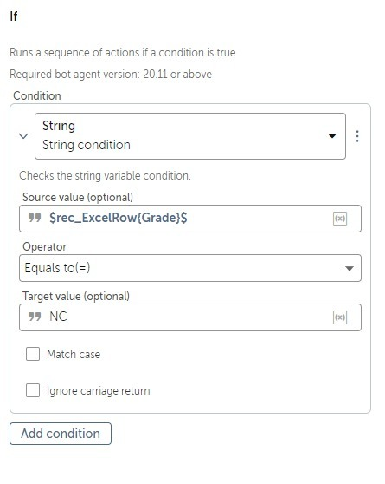
If condition
Line 10-
The bot checks the student's status (Passed/Failed) as per their grade.

Slide 28
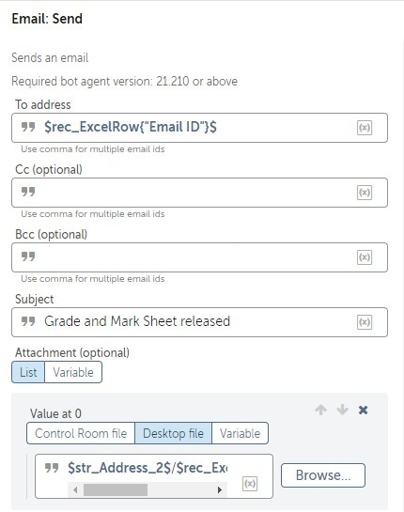
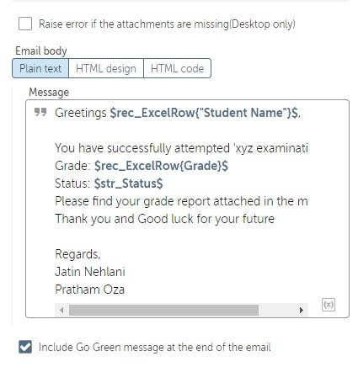
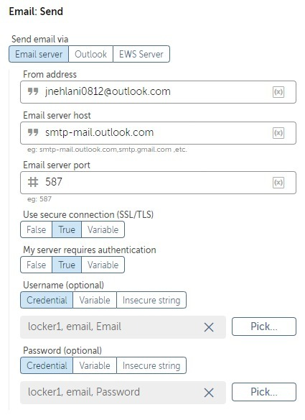
Email Send
Line 13-
The bot sends the Email to the Email ID of the particular student, writing down the student's grade and status and attaching the student's grade sheet from the folder of all the grade sheets.

Slide 29
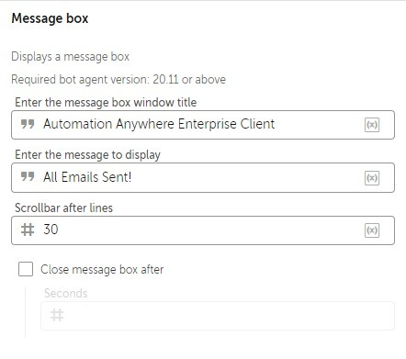
Message Box
Line 14-
The bot sends a confirmation message in the message box that all emails have been sent.

Slide 30
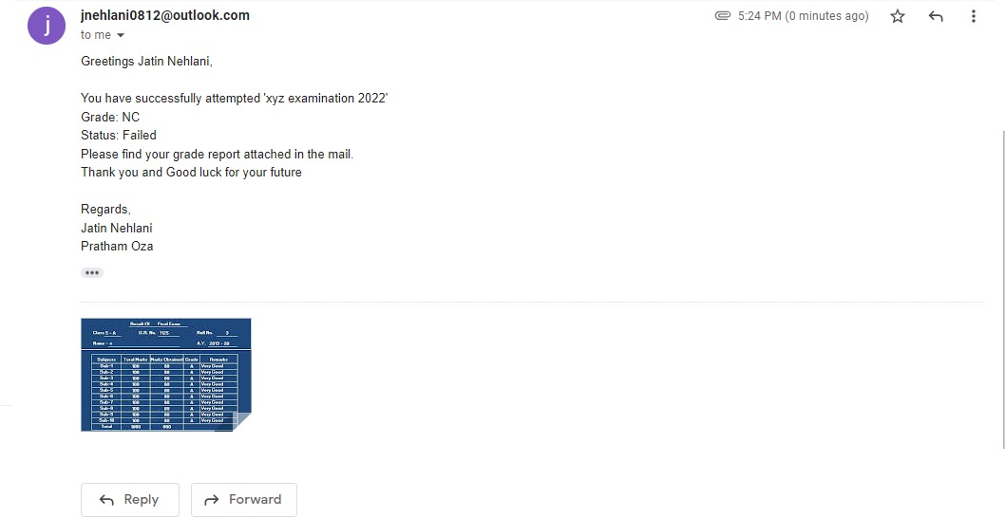
Testing

Slide 31
9.
Analysis
Notes:
Here we discuss one algorithm that enables doing the fast and power efficient use of IoT devices for training.

Slide 32
Analysis
For example, approximately 1000 students enroll in our college every year, so if a single person has to type emails and attach the grade sheet (Let’s assume it takes 2 min per mail), then it will take a very long time to execute the whole work (Approximately 33.4 hours). The chances of error are pretty high.
Although now, the person just has to run the bot, this bot will automatically send the mail to the respective students and attach the grade sheet. The efficiency of the bot is way more than a human. Email bot may take approximately 1.5 hours.

Slide 33
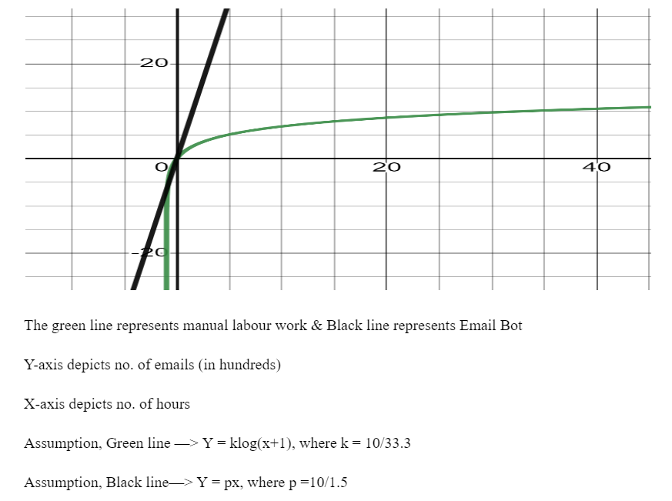
Analysis

Slide 34
10.
Conclusion
Notes:
Here we discuss one algorithm that enables doing the fast and power efficient use of IoT devices for training.

Slide 35
Analysis
RPA is an upcoming field, and all the software which supports it is very newly developed. This shows a high chance of automation being a significant part of the future and RPA being one of its pillars.
We found a detailed analysis of efficiency and time management for an email from our project. We used a grade confirmation email bot to demonstrate mailing to students with their names, grade remarks and pass/fail status along with their grade report as an attachment.
.

Slide 36
THANK YOU!
Notes:
.

